Slide 1
Smart Parking System
Parking slot availability and entry control
Team 8
Project Overview
JETHENDRA VARDHAN — 2620030600
LAXMI PRAGYA — 2620030602
VEDA CHANDRA — 2620030606
CHANDRA PAUL — 2620030636
SRIKRISHNA — 2620030675
Uses sensor inputs to check slot availability
Uses Boolean logic to control entry
Shows allow or deny status instantly
DDCA PROJECT
DIGITAL DESIGN
BOOLEAN LOGIC

Slide 2


The Problem & The Digital Solution
The Problem
Sensor Convention — Binary Input Definitions
Signal | Name | 0 | 1
S1 | Slot 1 | Free | Occupied
S2 | Slot 2 | Free | Occupied
S3 | Slot 3 | Free | Occupied
S4 | Slot 4 | Free | Occupied
E | Entry Request | No | Yes
Drivers can’t see free slots before entering
Cars still try to enter when full
Manual checks are slow and error-prone
No real-time slot or gate control
The Digital Solution
Turn slot status into binary signals
Use logic gates to read inputs in real time
Key principle: 0 = Free, 1 = Occupied.
Detect availability automatically
Allow entry only when available AND requested
Show a live PARKING_FULL signal

Slide 3
Inputs, Binary States & Parking Conditions
Parking Slot Sensors
NOT Gate Conversion
Invert each slot signal:
S1 — Slot 1
S2 — Slot 2
Signal | Meaning | Sn=0 | Sn=1
¬S1 | Slot 1 free | 1 | 0
¬S2 | Slot 2 free | 1 | 0
¬S3 | Slot 3 free | 1 | 0
¬S4 | Slot 4 free | 1 | 0
1 = Occupied | 0 = Free
1 = Occupied | 0 = Free
S3 — Slot 3
S4 — Slot 4
1 = Occupied | 0 = Free
1 = Occupied | 0 = Free
Entry Request
E — Entry Request
1 = Request | 0 = No request
1 means the slot is free. The OR gate checks overall availability.

Slide 4

Logic Gates — Sensors to Entry
Stage 1 — NOT
Stage 4 — Full Parking
S1 = 1 → ¬S1 = 0
S1 = 0 → ¬S1 = 1
Same for S2, S3, and S4
Parking is full when all slots are occupied:
PARKING_FULL = ¬AVAILABLE = S1 · S2 · S3 · S4
Stage 2 — OR
Gate Summary
Checks if any slot is free:
Gate | Inputs | Output | Use
NOT ×4 | S1–S4 | ¬S1–¬S4 | Invert
OR (4-in) | ¬S1–¬S4 | AVAILABLE | Find free slot
AND (2-in) | AVAIL, E | ENTRY_ALLOWED | Allow entry
NOT (1-in) | AVAILABLE | PARKING_FULL | Full alert
AVAILABLE = ¬S1 + ¬S2 + ¬S3 + ¬S4
Stage 3 — AND
Entry needs availability and request:
ENTRY_ALLOWED = AVAILABLE · E
= (¬S1 + ¬S2 + ¬S3 + ¬S4) · E
No memory, no clock — just current inputs.

Slide 5
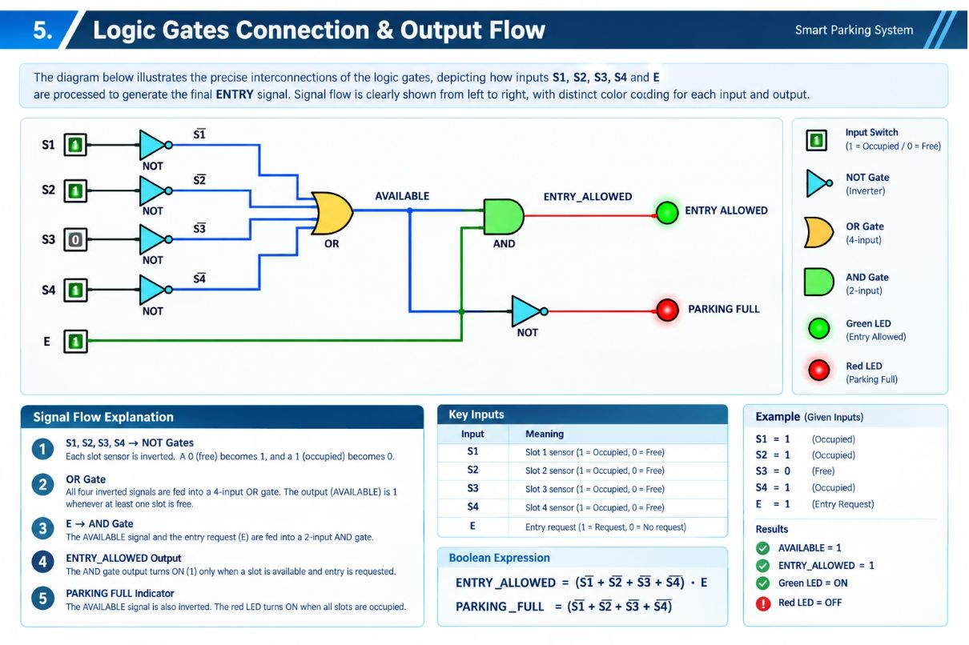
Logic Gates Connection & Output Flow
Circuit Operation — Left to Right
Worked Examples
1
Sensor Inputs
Example 1: S1=1, S2=1, S3=0, S4=1, E=1
S1–S4 enter as 1 = Occupied, 0 = Free
AVAILABLE = 1
ENTRY_ALLOWED = 1
ENTRY ALLOWED ✓
2
NOT Gates
Invert each sensor: ¬S1, ¬S2, ¬S3, ¬S4
Example 2: S1=1, S2=1, S3=1, S4=1, E=1
3
OR Gate
AVAILABLE = 0
PARKING_FULL = 1
ENTRY_ALLOWED = 0
ENTRY DENIED ✗
AVAILABLE = ¬S1 + ¬S2 + ¬S3 + ¬S4
4
AND Gate + Full Signal
ENTRY_ALLOWED = AVAILABLE · E
PARKING_FULL = ¬AVAILABLE

Slide 6
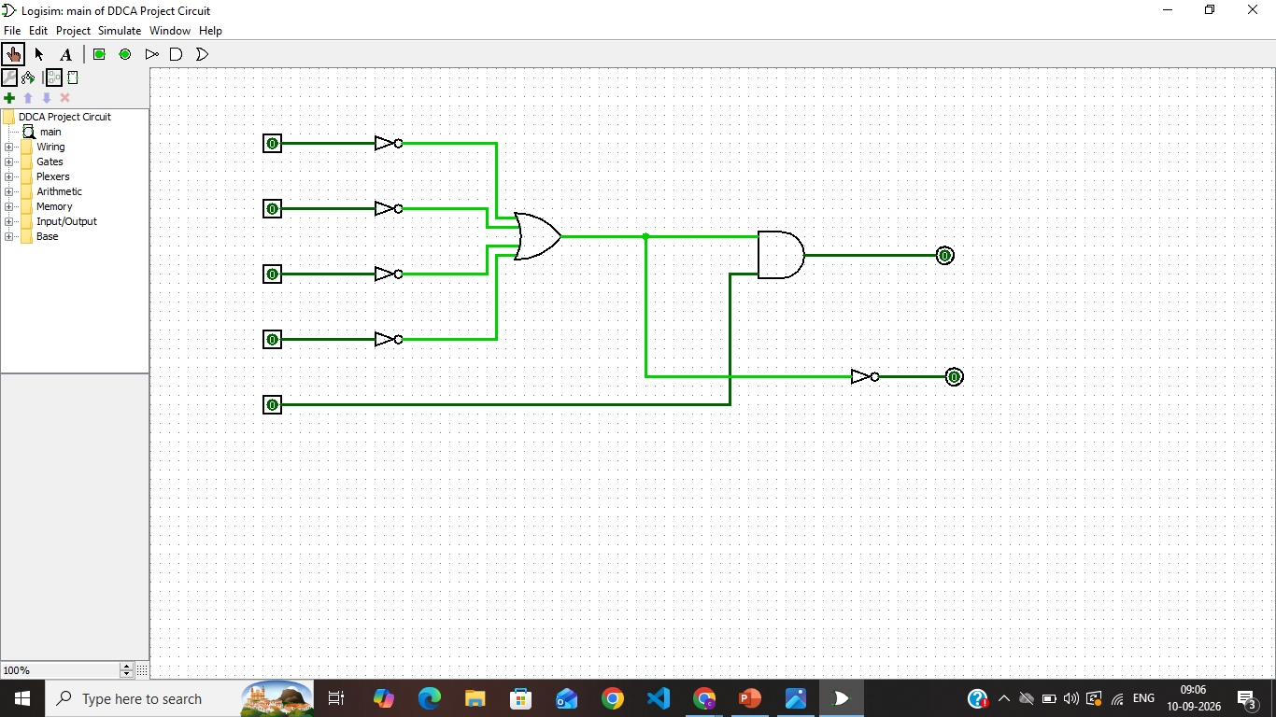
Simulation & Decision Logic
Step-by-Step Process
Simulation Cases
01
Case A — Spot Free, Entry On
Case B — Parking Full
Case C — Spot Free, No Entry
Read Sensors
S1=1, S2=1, S3=1, S4=1, E=1
Get S1, S2, S3, S4
S1=1, S2=0, S3=1, S4=1, E=1
AVAILABLE = 0
ENTRY_ALLOWED = 0
PARKING_FULL = 1
S1=1, S2=0, S3=1, S4=1, E=0
02
AVAILABLE = 1
ENTRY_ALLOWED = 1
AVAILABLE = 1
ENTRY_ALLOWED = 0
Invert Signals
ENTRY PERMITTED ✓
ENTRY DENIED ✗
NO ENTRY
Make ¬S1, ¬S2, ¬S3, ¬S4
E must be 1 to allow entry.
03
Find Availability
AVAILABLE = ¬S1 + ¬S2 + ¬S3 + ¬S4
04
Check Request
Read input E
05
Decide Entry
ENTRY_ALLOWED = AVAILABLE · E

Slide 7

Truth Table & Logic Verification
Simplified Truth Table — Parking Logic
Logic Checks
Parking Condition | AVAILABLE | E | ENTRY_ALLOWED | PARKING_FULL
One slot free | 1 | 0 | 0 | 0
One slot free | 1 | 1 | 1 | 0
All slots full | 0 | 0 | 0 | 1
All slots full | 0 | 1 | 0 | 1
Free + Request
AVAILABLE=1 and E=1 → ENTRY_ALLOWED=1.
Full Parking
AVAILABLE=0 → ENTRY_ALLOWED=0.
No Request
E=0 → no entry.
No Memory
Output depends only on current inputs.
ENTRY_ALLOWED = 1 only when AVAILABLE=1 and E=1.

Slide 8





Conclusion
Project Summary
Key Design Features
4 Binary Sensors
Verified
Scalable
S1–S4 show whether each parking slot is occupied or free.
Matches the truth table.
Add more slots by expanding the logic.
NOT Gates
Convert occupied slots into free-slot signals: ¬S1, ¬S2, ¬S3, ¬S4.
Combinational
OR Gate
No clock or memory.
AVAILABLE = ¬S1 + ¬S2 + ¬S3 + ¬S4
AND Gate
Design Flow
ENTRY_ALLOWED = AVAILABLE · E
BITS
Full Parking
PARKING_FULL = S1·S2·S3·S4
LOGIC
CIRCUIT
DECISION

